Slide 1
File Inclusion Vulnerability
By –Prakash Khasor, Assistant Professor(Cyber Security), National Forensic Sciences University

Slide 2
Introduction
What is File Inclusion Vulnerability
Methodology
Impact
Mitigations

Slide 3
File Inclusion Vulnerability
The File Inclusion vulnerability allows an attacker to include a file, usually exploiting a “dynamic file inclusion” mechanisms implemented in the target application. The vulnerability occurs due to the use of user-supplied input without proper validation.
CWE-98: “Improper Control of Filename for Include/Require Statement in PHP Program”.
CWE-20: “Improper Input Validation”.
CWE-22: “Improper Limitation of a Pathname to a Restricted Directory (‘Path Traversal’)”.
CWE-23: “Relative Path Traversal”.
CWE-200: “Exposure of Sensitive Information to an Unauthorized Actor”.

Slide 4
Impact of File Inclusion
This Vulnerability is mainly due to a bad input validation mechanism, wherein the user's input is passed to the file include commands without proper validation. The impact of this vulnerability can lead to malicious code execution on the server or reveal data present in sensitive files, etc.
Code execution on the Web server
Cross-Site Scripting Attacks (XSS)
Denial of service (DOS)
Data Manipulation Attacks
Sensitive Information Disclosure

Slide 5
Types of File Inclusion
RFI ”Remote File Inclusion”
Remote File Inclusion (RFI) is a method that allows an attacker to employ a script to include a remotely hosted file on the webserver.
LFI ” Local File Inclusion”
Local File Inclusion (LFI) is very much similar to RFI. The only difference being that in LFI, in order to carry out the attack instead of including remote files, the attacker has to use local files.

Slide 6
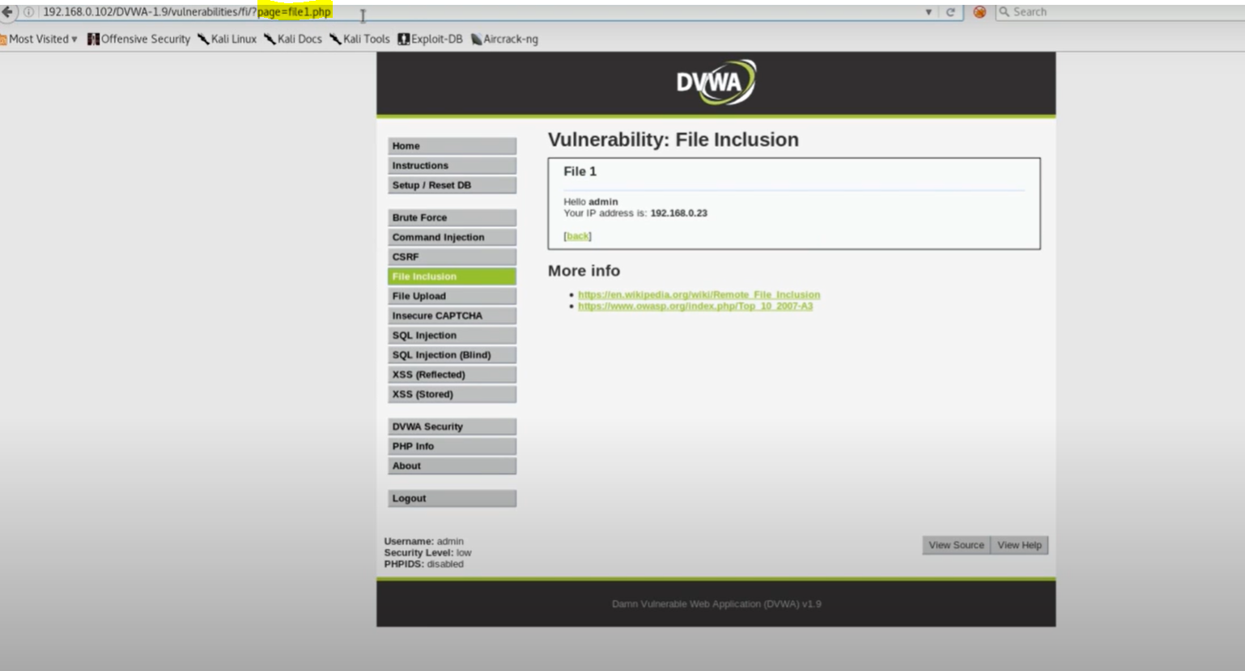
Practical Scenarios
Demo1=Low Security

Slide 7
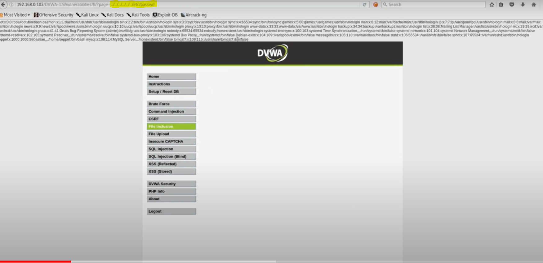
../../../../../../etc/passwd

Slide 8
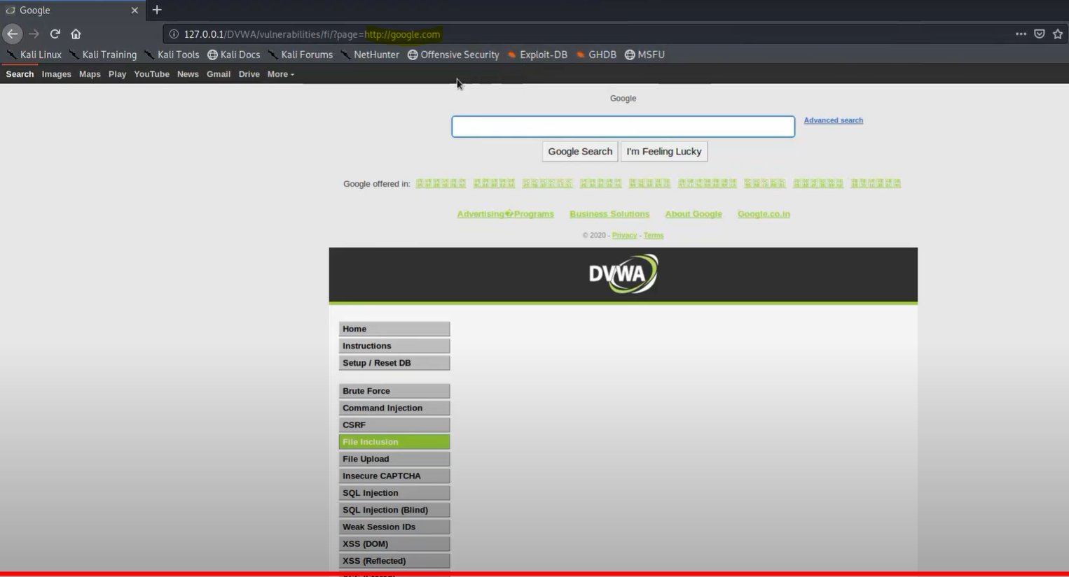
RFI URL=GOOGLE.COM

Slide 9
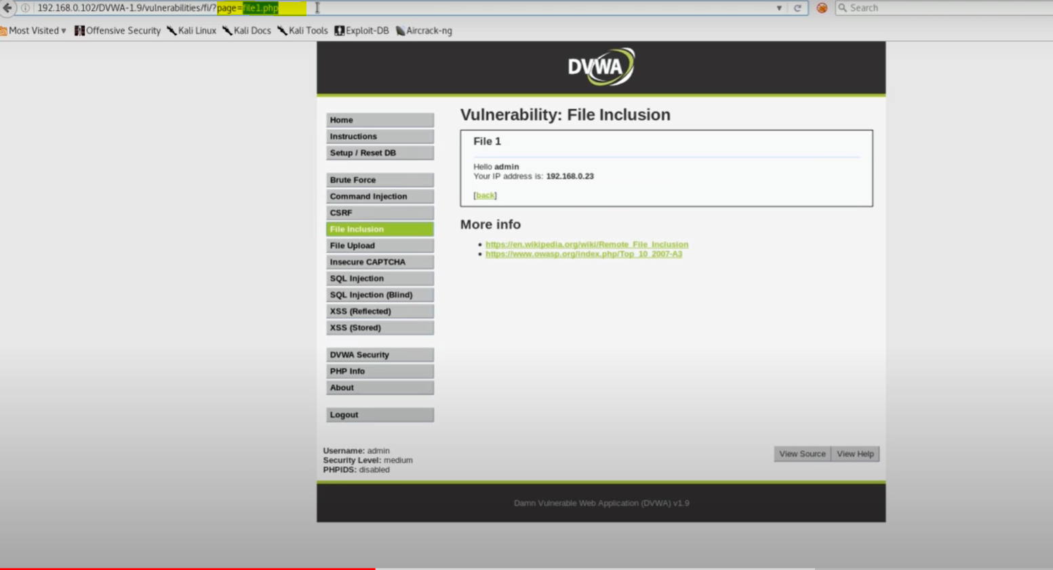
MEDIUM

Slide 10
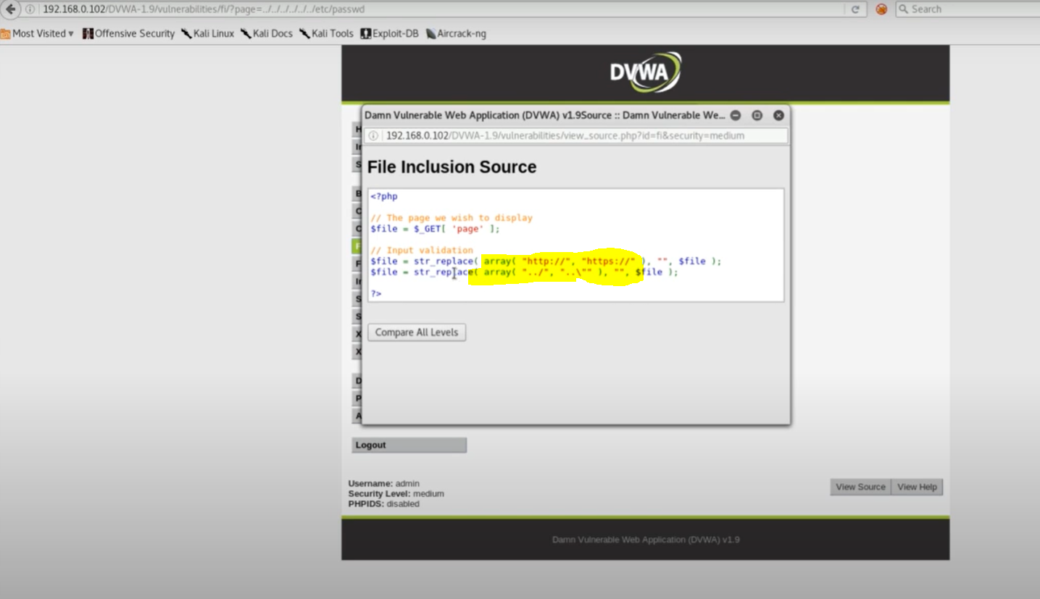
CHECK PATTERN IN SOURCE CODE

Slide 11
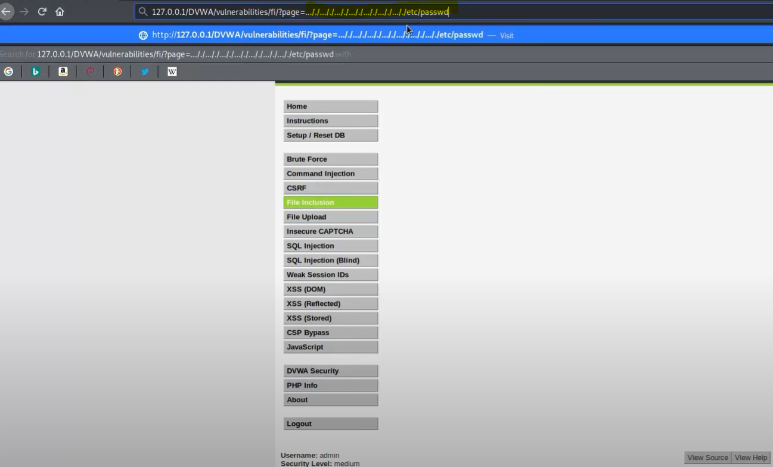
BYPASS BLACKLIST

Slide 12
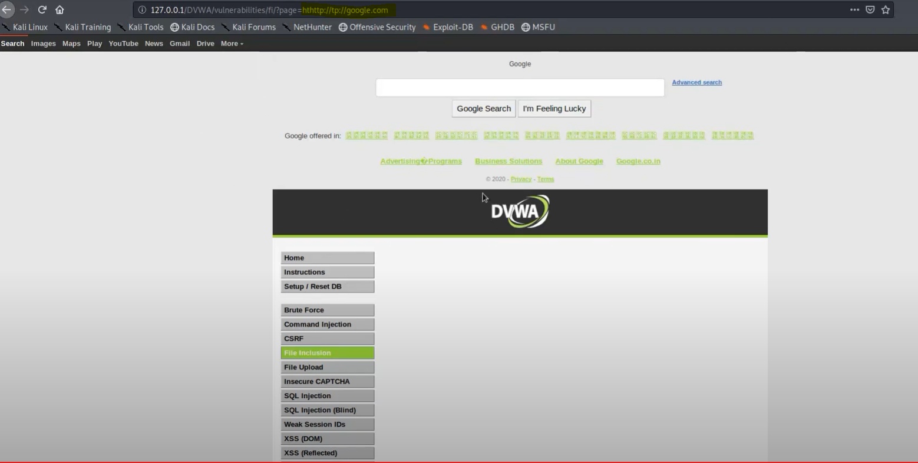
BYPASS FOR RFI

Slide 13
Mitigations
Don’t Permit File paths to be appended Directly. Make them Hardcoded of Selectable from limited Hardcoded path list with the help of an index variable.
If you definitely need dynamic path concatenation, ensure you only accept required characters such as "a-Z0-9" and do not allow ".." or "/" or "%00" (null byte) or any other similar unexpected characters.
limit the API to allow inclusion only from a directory and directories below it. This ensures that any potential attack cannot perform a directory traversal attack.

Slide 14


